Slide 1


Choosing The Best Neighbourhood for Nigerian Barbeque Business in Toronto

Slide 2
The Problem
Yahuza Suya wants to open a new branch of their Nigerian-style barbeque chicken and beef in Toronto.
They want to eliminate the likelihood of failure as much as possible.
They are clear about their factors for success
1. Safety and Security
2. Income within pricing market
3. Close to transportation stations- due to immigrant community presence

Slide 3
My proposed solution
1. Get the data on the various neighbourhoods
2. Compare them against others
3. Pick out the neighbourhoods that meet this criteria most
4. Pick out the neighbourhood that satisfies these conditions and is supported by research

Slide 4
Data
1. Crime Data
2. Income Data
3. Transportation station data
4.Toronto postal codes, neighbourhoods and coordinates data
5. Foursquare Data

Slide 5
Tools
1. Dataframes
2. Maps
3. Foursquare API
4. CSV Tables

Slide 6
Python Libraries,Functions and Techniques Used
1 NumPy for computation
2. Folium for building maps
3. Pandas for handling dataframes
4. BeautifulSoup for scraping websites for data
5. Requests for getting results
6. Geopy for handling location data
7. sklearn for k-means clustering

Slide 7
Sources of Data
Sources
General Toronto data was obtained from
https://en.wikipedia.org/wiki/List_of_postal_codes_of_Canada:_M
The demographic data was obtained from https://en.wikipedia.org/wiki/Demographics_of_Toronto_neighbourhoods
The crime data was obtained from http://data.torontopolice.on.ca/datasets?q=crime
The list of Metro stations was obtained from https://en.wikipedia.org/wiki/List_of_Toronto_subway_stations

Slide 8
Methodology
We first import all necessary libraries. We ignore libraries like folium and sklearn until we need them so that it does not slow down the processing
Neigbourhood Data- Scrape
https://en.wikipedia.org/wiki/List_of_postal_codes_of_Canada:_M.
The resulting dataframe:

Slide 9
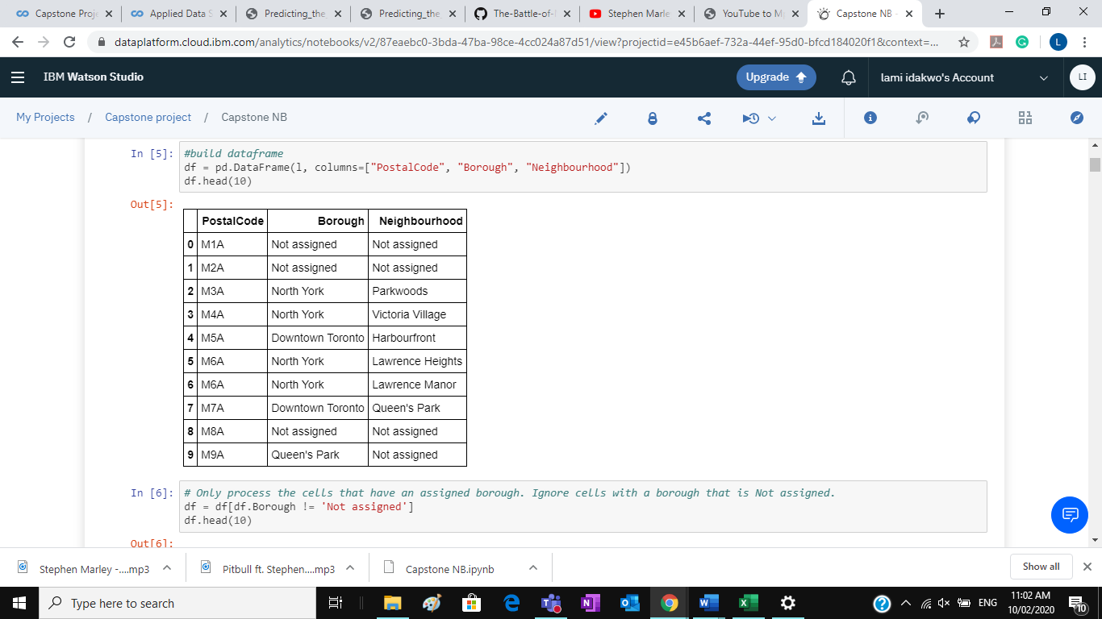

Slide 10
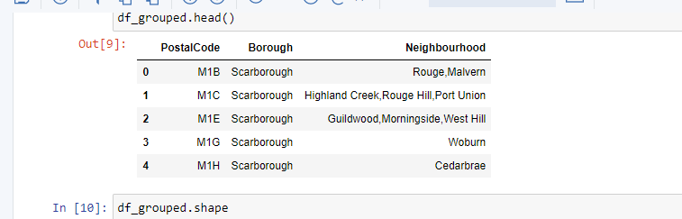
I clean up, drop non-assigned cells and rename cells to ensure consistency . The resulting dataframe is:

Slide 11
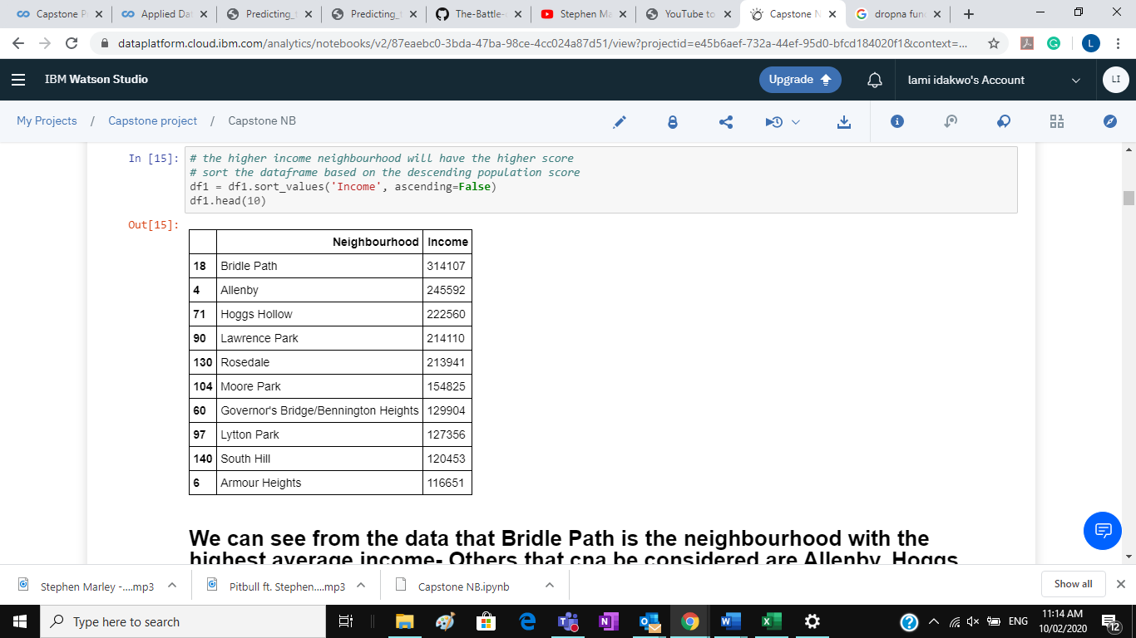
Income Data:
We scrape 'https://en.wikipedia.org/wiki/Demographics_of_Toronto_neighbourhoods’
After cleaning and sorting we have :

Slide 12
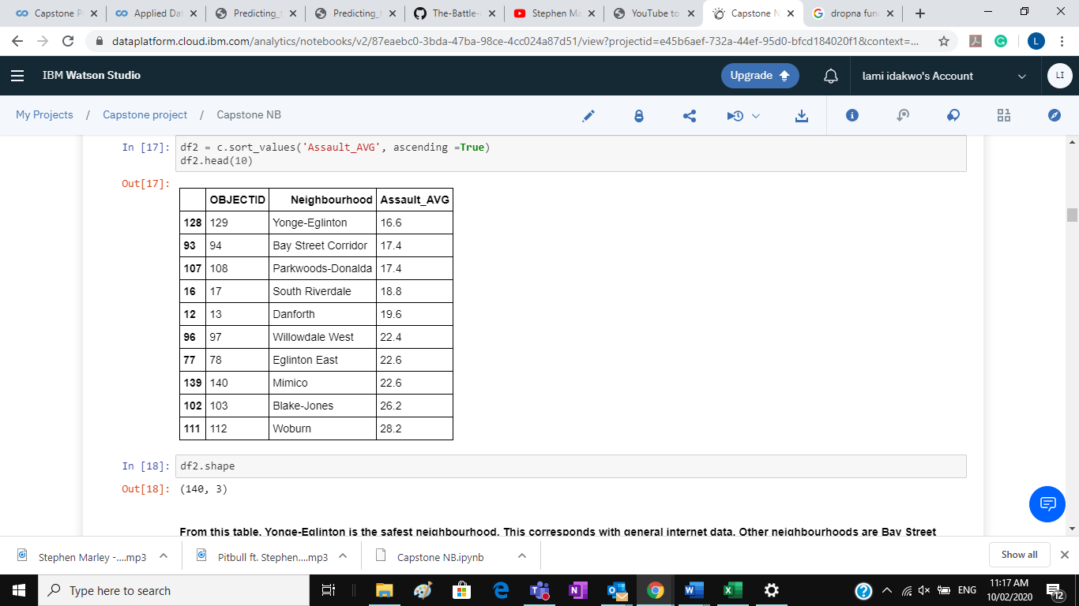
Crime Data
We import csv . Originally extracted from data.torontopolice.ca, it was cleaned and sorted then uploaded
On a website . Resulting Dataframe:

Slide 13
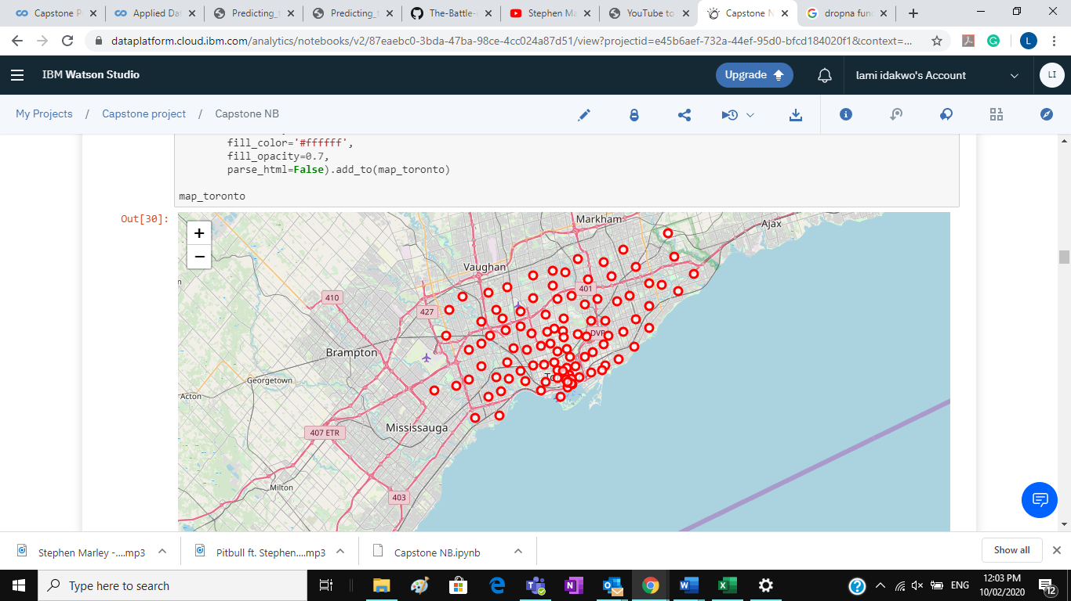
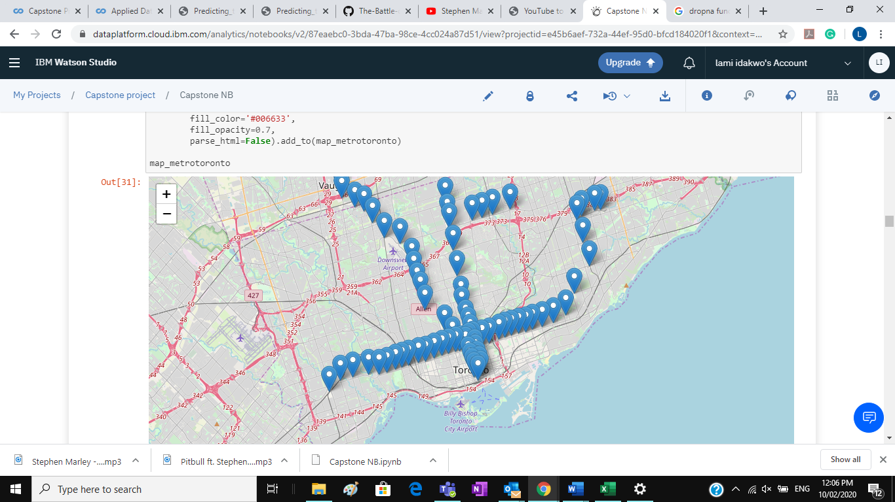
Visualization of Toronto and Toronto Metro Stations

Slide 14
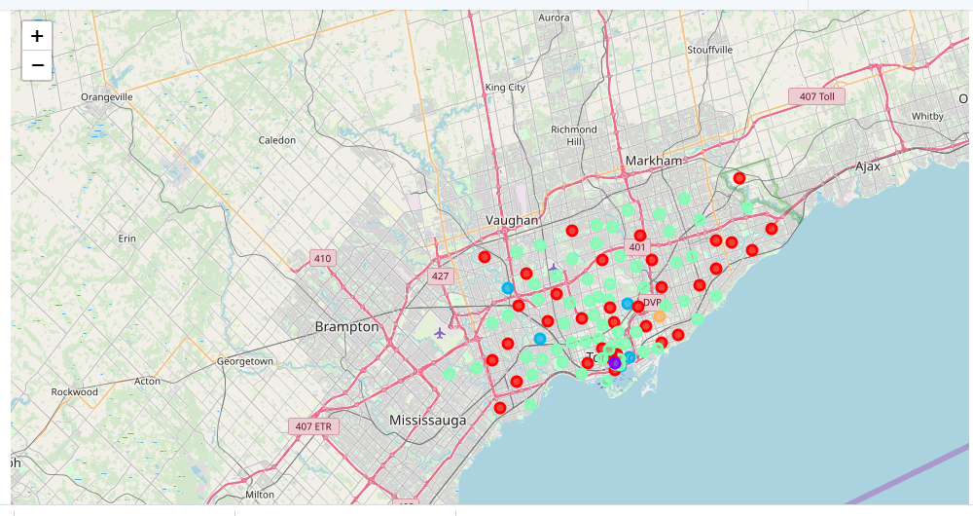
USING FOURSQUARE, WE OBTAIN VENUE RESULTS AND PERFORM K-MEANS
Cluster visualisation below where k=5

Slide 15
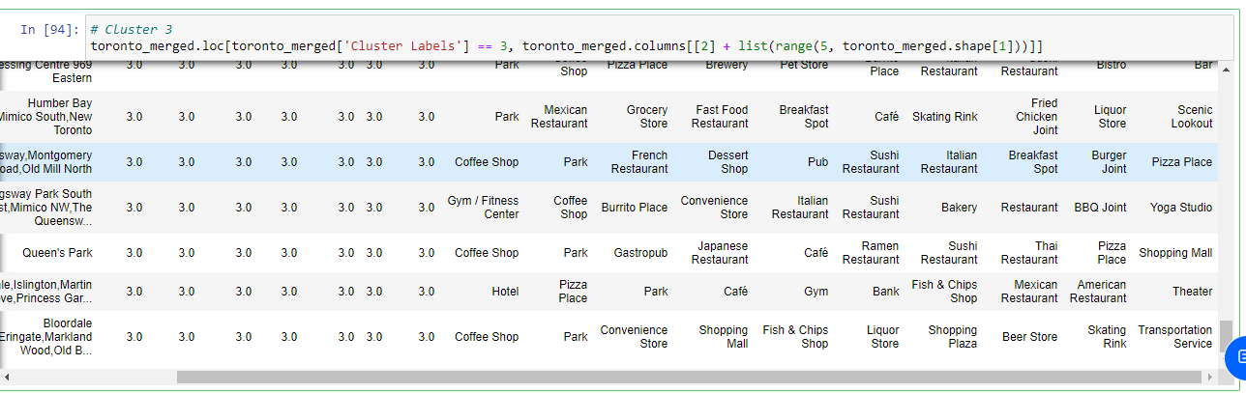
A snapshot of cluster 3 which is our where our preferred neighbourhood is likely to come from:

Slide 16
BY narrowing down on the neighbourhoods which satisfy our conditions and also fit the likely clusters, we came to:
Lawrence Park
Rosedale
Parkwoods
Willowdale West
Riverdale West
Mimico
On further observation,, we narrow down to three and have more specific results, I look closely and see that:
1.Lawrence Park satisfies all the three requirements and is close to a college.
This will attract young adults who have an active nightlife.
2. Willowdale West is also a good idea as it satisfies the requirements.
3. The third option will be Parkwoods, which also satisfies the requirement of safety and income.
Further search reveals there are many immigrants.

Slide 17
CONCLUSIONS
Choosing a good neighbourhood usually depends on more than one factor. In most cases, it is usually a healthy combination of important factors.
For this task, while safety and pricing were major factors, it would have been counter productive to choose based on these two factors alone. The use of foursquare data and the venues provided gave us a more descriptive view of these neighbourhoods and we are able to make a more robust decision.
Such tasks show the important of Data Science as it enables fact-based decision-making, even if it means coming to the same assumption.

Slide 18
Without Data, You’re just another person with an opinion
- w. Edwards deming

